Slide 1
Title
      Name : Prashik Ganesh Gawai
Professional Program in Data Analytics with GenAI-71
      Mentor Name : Ashish Rajput
      Project Type : Python DBA

Slide 2


Dataset Description
    Topic Name : E-Commerce Store Sale
Industry : Finance (Sales)
      Data : 600 Rows &
      17 Columns
Tools

Slide 3

Objectives :
Objective 1 :- Data Understanding & Cleaning
Objective 2 :- Customer & Sales Analysis
Objective 3 :- Visualize the Data for Better Understanding
Objective 4 :- Store and Manage Data (SQL)

Slide 4
Sr No. | Objectives | Tasks | Tools
1 | Objective 1: Understand the Data Clearly | 1.1 : Remove duplicate or unwanted data 1.2 : Create new columns for better understanding 1.3 : Convert date into useful format | Python Pandas NumPy
2 | Objective 2: Analyze Customer and Business Patterns | 2.1 : Find which service/category is most popular 2.2 : Analyze customer ratings and pricing 2.3 : Compare different cities or categories | Python NumPy
3 | Objective 3: Visualize the Data for Better Understanding | 3.1 : Create bar charts to compare sales across states and platforms 3.2 : Use pie charts to show category or platform share 3.3 : Generate heatmaps and distributions to identify patterns | Matplotlib Seaborn
4 | Objective 4: Store and Manage Data (SQL) | 4.1 : Save cleaned data into database 4.2 : Retrieve data when needed 4.3 : Check if data is stored correctly | SQL SQLAlchemy Pandas

Slide 5
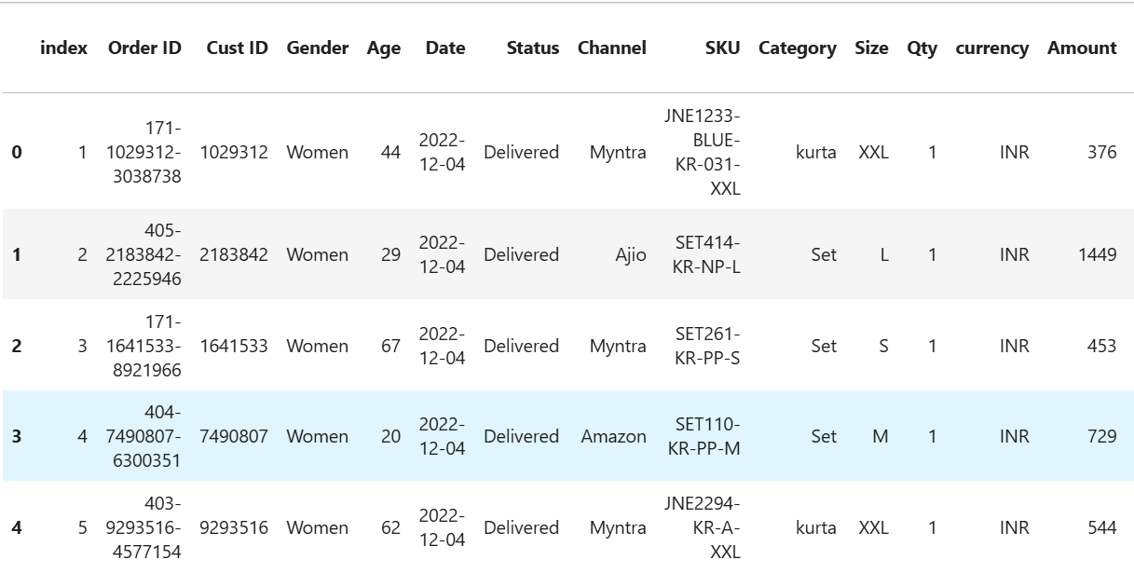
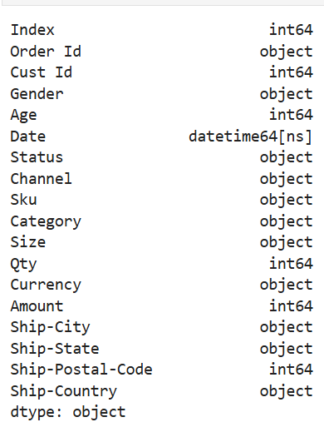
Objective 1 :- Data Understanding & Cleaning
Vrinda Store Sales Understanding

Slide 6

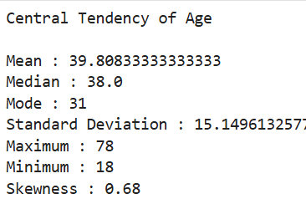
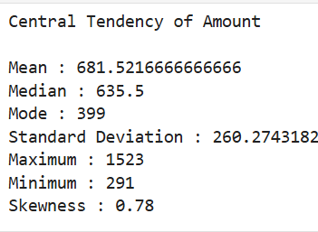
Objective 2 :- Customer & Sales Analysis
Central Tendency of Age
Central Tendency of Amount
Age b/w 35-40 are most purchasing
The Average Amount of product is ₹635

Slide 7
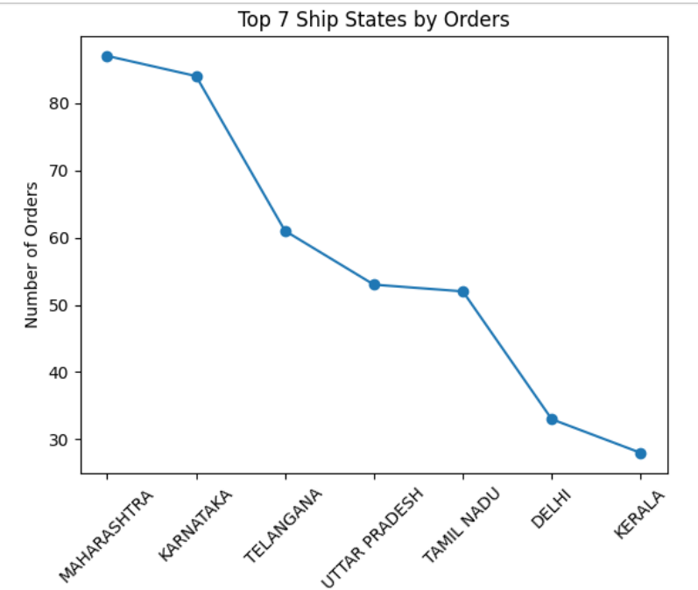
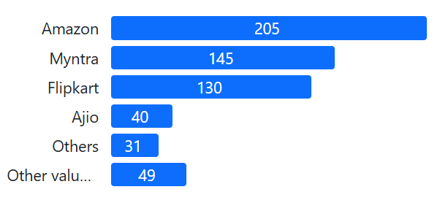
Objective 3 :- Visualize the Data for Better Understanding
Most using Application for sales
Top 7 States for Sales
Amazon is most used
For sales Maharashtra is No.1

Slide 8

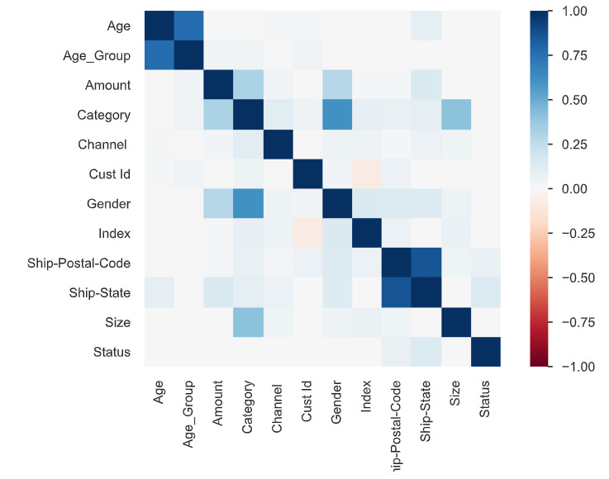
Objective 4 :- Store and Manage Data
(SQL)
Key Insights from Correlation Heatmap
Correlation
Age ↔ Age Group
Ship-Postal-Code ↔ Ship-State
Category ↔ Gender

Slide 9

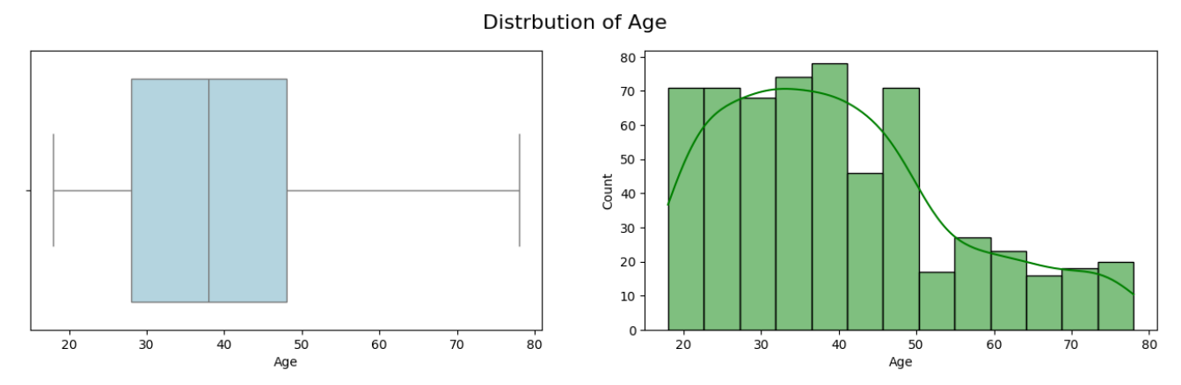

Objective 4 :- Store and Manage Data
(SQL)
Distribution of Age by Sales
Age between 25 – 40 Are most purchasing product

Slide 10
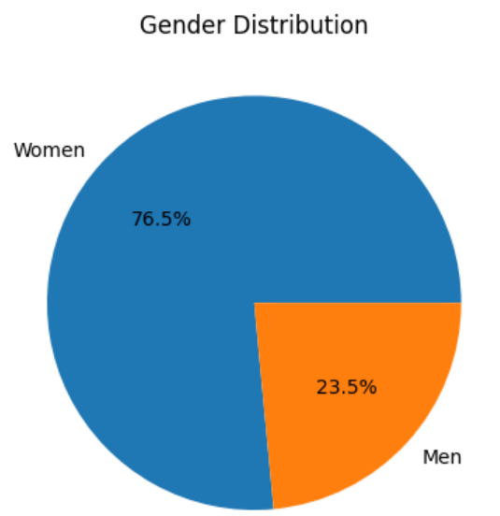
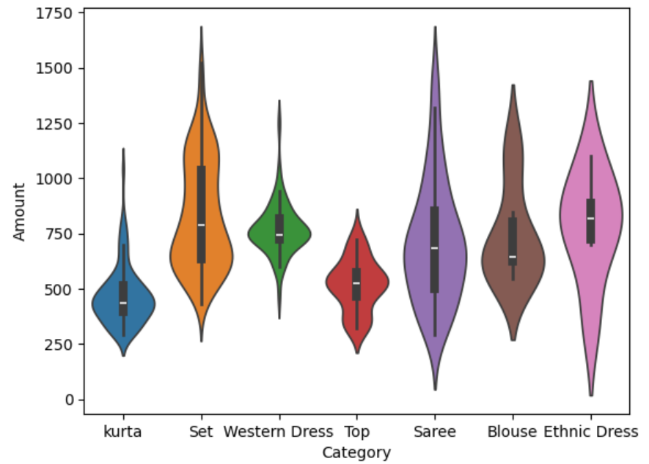
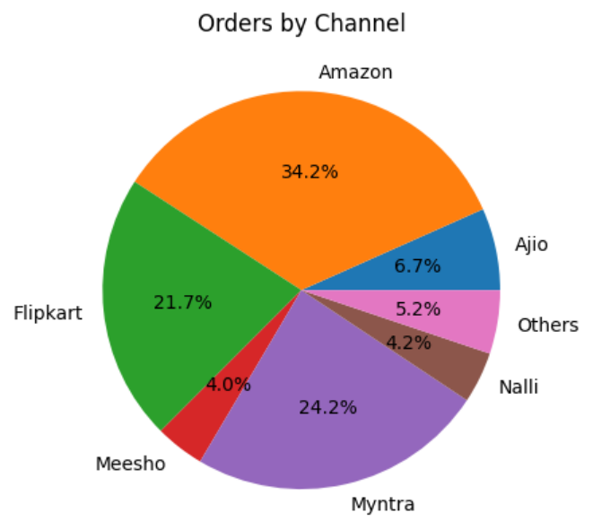
Dashboard
Vrinda Store Sales Report
Income
₹ 4.08L
Application
Amazon
Top city
Maharashtra

Slide 11
Summery
The project is based on E-Commerce Store Sales Data analysis.
Data cleaning was performed by removing duplicates and handling missing values.
Date columns were converted into proper format for analysis.
Used Python libraries like Pandas, NumPy, Matplotlib, and Seaborn.
Performed Exploratory Data Analysis (EDA) to understand trends and patterns.
Identified most popular platform as Amazon.
Found Maharashtra as the top-performing state in sales.
Observed that age group 25–40 contributes the highest purchases.
Average product amount is around ₹635.
Total revenue generated is approximately ₹4.08 Lakhs.

Slide 12
Conclusion
Sales are highly influenced by customer age group.
Customers aged 25–40 years are the most active buyers.
Amazon platform plays a major role in sales growth.
Maharashtra is the key region for business performance.
Customer behavior analysis helps in better decision-making.
Data visualization makes complex data easy to understand.
EDA helps in identifying hidden patterns and trends.
Businesses should focus on high-performing platforms.
Marketing should target the most active customer segment.
Data-driven decisions improve overall business efficiency.
Storing data in SQL helps in better data management and retrieval.
Overall, data analysis helps increase sales and profitability.

